Slide 1
IoT Enabled Non-Invasive Method for Early Detection of Cardiotoxicity
Team no: 30
Mentor: Dr.R.Kathiroli
Assistant Professor
Team Members:
Aishwarya Devi R (2021503501)
Surya Raj M (2021503701)
Sridhar P (2021503709)

Slide 2
Problem Statement:
CVDs are the leading cause of death globally, claiming millions of lives each year.
Early detection and intervention are crucial for improving patient outcomes and reducing mortality rates.
However, traditional methods for detecting cardiotoxicity often involve invasive procedures and lack real-time monitoring capabilities.

Slide 3
Objective:
Identify abnormal patterns, specifically Arrhythmia, within 12-channel ECG signals for precise detection and characterization.
Forecast cardiovascular issues in diverse populations, including cancer patients, sports individuals, and normal controls, by analyzing elevated levels of cardiac troponin (cTn).
Enable real-time predictions of heart functions, prioritizing a proactive approach over a diagnostic perspective for timely interventions and improved healthcare outcomes.
Develop a non-invasive tool using IoT-based cardiac biosensors and Deep Learning (DL) algorithms to accurately extract and predict cTn levels.

Slide 4
Literature Survey:
Sl.No | Paper Title | Methodology | Limitations
1. | IoT Based Smart Monitoring of Patients with Acute Heart Failure Year: 2022 Journal: Sensors | A comparative analysis was conducted on the classification of heart failure using 13 features, employing various models including CNN, RNN, MLP, and LSTM. CNN shows superiority with an accuracy of 92.89%. The study incorporated IoT sensors for monitoring heart rate, blood pressure (BP), temperature and ECG signals. | Dataset is highly imbalanced. Model is not trained well on minority classes.
2. | Arrhythmia detection using deep convolutional neural network with long duration ECG signals Year: 2018 Journal: Computers in Biology and Medicine | This paper proposes methodology for classifying cardiac arrythmia into 17 classes, considering long duration ECG signal of 10s. It employs 1D CNN with 16 layer deep, achieving accuracy of 91.33% and classification time of 0.015 s. It particularly focuses on reducing the computational complexity. | Small no of ECG signal fragments are analysed. No possibility of classifying fragments of ECG signal containing more than one class.

Slide 5
3. | An IoT Framework for Heart Disease Prediction Based on MDCNN Classifier Year: 2020 Journal: IEEE Access | The study employs a Modified Deep CNN for classification and integrates the Elephant Herd Optimization Algorithm (AEHO). Feature selection is done by Cuttlefish Optimization Algorithm. Simulation is achieved through the integration of microcontroller and LoRa communication hardware for data transmission to the cloud. Use of Omron HeartGuide smartwatch for blood pressure measurement and the AD8232 for ECG measurement. | Actual data for serum cholesterol, chest pain and glucose level are not used, pseudo numbers are generated
4. | A single-lead ECG based cardiotoxicity detection in patients on polychemotherapy Year: 2024 Journal: IJC Heart & Vasculature | The study employs single-lead ECG to detect cardiotoxicity in cancer patients with minimal cardiovascular diseases following the first cycle of polychemotherapy. Utilizes the CardioQvark mobile phone cover with an integrated ECG sensor for signal detection. Detection focuses on identifying left ventricular diastolic dysfunction, atrial fibrillation, and QTc prolongation. | Sample did not include patients with intermediate and low LVEF

Slide 6
5. | A Wearable ECG Monitor for Deep Learning Based Real-Time Cardiovascular Disease Detection Year: 2022 Journal: arXiv | The proposed wearable ECG monitoring system, IREALCARE, consists of an integrated ECG sensor where ECG data is collected, transmitted to the control unit, sampled at 250Hz, converted to digital signals using ADC. The ECG signals are wirelessly transmitted to a mobile device via Bluetooth. Preprocessing of the ECG involves enlarging by sliding window and denoising using Discrete Wavelet Transform (DWT). The system employs a confidence level-based training approach with ResNet as the training model, achieving an accuracy of 90.2%. | Relies heavily on the optimal selection of the confidence level, which may vary based on the dataset and label quality
6. | Predicting cardiovascular events with deep learning approach in the context of the internet of things Year: 2021 Journal: Neural Computing & Applications | The approach utilized in the study is LSTM-DBN, achieving an accuracy of 88.42%. This approach combines LSTM for learning long-term dependencies with DBN for feature selection. Stochastic Gradient Descent (SGD) is employed for optimizing the loss function. Comparative analysis is conducted with four other deep learning approaches (CNN, RNN, GRU, Ensemble) and four machine learning approaches (MLP, LR, SVM, RF). | High computational efficiency and memory is required for DBN as compared to other algorithms.

Slide 7
7. | IoT-Based System for Heart Monitoring and Arrhythmia Detection Using Machine Learning Year: 2023 Journal: J Healthc Eng | The study focuses on remote monitoring of cardiac signals through the integration of IoT and machine learning techniques, with detction of various arrhythmia including ventricular, supraventricular, and fusion beats. The components include the Polar H10 ECG sensor for signal acquisition, a CRUD REST API for data management, a Monitoring GUI for visualization, an Arrhythmia Detection Component for automated analysis. Utilizes MQTT protocol for communication. The chosen algorithm for arrhythmia classification is k-nearest neighbors with accuracy of 97%. | Lack of discussion on robustness to noise and variability in ECG signals.
8. | An Efficient IoT-Based Platform for Remote Real-Time Cardiac Activity Monitoring Year: 2020 Journal: IEEE Transactions On Consumer Electronics | The system enables real-time monitoring of ECG signals by filtering and localizing R-peaks using the Pan Tompkin’s algorithm. Feature extraction is performed using a combination of Fast Fourier Transform (FFT) and discrete wavelet transform (DWT). Classification of extracted features is achieved through twin support vector machines (TSVM) tuned by Particle Swarm Optimization (PSO). The prototype is implemented on a microcontroller platform equipped with a Wi-Fi module for data transmission and connectivity. | More specific selection of features based on R-wave morphology. Lacks the discussion about power consumption of the platform.

Slide 8
9. | Deep Learning-Based Data Augmentation and Model Fusion for Automatic Arrhythmia Identification and Classification Algorithms Year: 2022 Journal: Computational Intelligence and Neuroscience | The approach utilized is ECG-GAN for data augmentation and the ResNet BiLSTM-Attention for classification achieving accuracy of 99.4%. ResNet is used for local feature extraction and BiLSTM for global feature extraction. DWT is used for denoising and QRS waveform detected using Pan Tompkin’s algorithm. | Integrating ResNet and BiLSTM models introduces complexity to the classification process Optimization of hyperparameters is not performed.
10. | Detection of Cardiovascular Diseases in ECG Images Using Machine Learning and Deep Learning Methods Year: 2023 Journal: IEEE Transactions On Artificial Intelligence | This paper presents a lightweight Convolutional Neural Network (CNN) model for predicting four major cardiac abnormalities using a public dataset of ECG images. The study investigates transfer learning using low-scale pretrained deep neural networks (SqueezeNet and AlexNet) and proposes a new CNN architecture for cardiac abnormality prediction achieving 99.79% accuracy. The pretrained models and the proposed CNN model are used as feature extraction tools for traditional machine learning algorithms. | Training and testing time for SquuezeNet based algorithm is longer. Optimization algorithms are not used to determine the value of hyperparameters.

Slide 9
Proposed System
M1: Preprocessing and feature extraction
M2: Model training using CNN
M4: Model training using LSTM based RNN
M5: Model training using MobileNet
M6: Prediction of heart failure
M8: IoT device fabrication and deployment
M7: Performance evolution of the models
M3: Model training using U-net

Slide 10
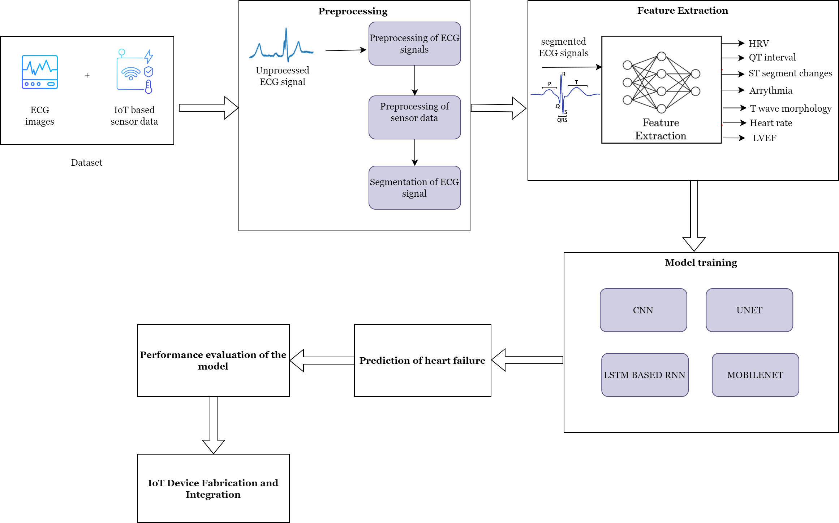
System Model

Slide 11
Module 1
Preprocessing of ECG signals
Preprocessing of sensor data
Segmentation of ECG signals
Filtering the ECG signal
Peak Detection
Feature Extraction

Slide 12
Algorithm 1: ECG Analysis Algorithm
REQUIRE : ECG signal data
ENSURE : HRV features, QT intervals, ST segment changes, heart rate, LVEF
Load ECG signal from file
Extract R-peaks for each lead
Calculate HRV features for each lead
Calculate QT intervals for each lead
Analyze ST Segment changes
Calculate Heart Rate
Estimate LVEF
OUTPUT:
HRV features
QT Intervals
ST Segment changes
Heart Rate
LVEF

Slide 13
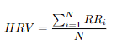



Cardiovascular Metrics in ECG Analysis:
Heart Rate Variability:
QT intervals:
ST segment:
Heart Rate:

Slide 14
Evaluation Metrics
Accuracy
Precision
Recall
Specificity
F1-score
AUROC curve
Confusion matrix
Accuracy=TP + TN / TP + TN + FP + FN
Precision=TP / TP + FP
Recall=TP / TP + FN
Specificity=TN / TN + FP
F1-score=2 × Precision × Recall / Precision + Recall

Slide 15
Conclusion and Impact
The proposed IoT-based biosensor system offers a promising solution for:
Continuous and remote cardiac monitoring.
Non-invasive HF prediction using advanced DL algorithms.
Improved healthcare services for remote populations.
This system has the potential to:
Reduce the burden of CVDs globally.
Improve patient quality of life by enabling early intervention.
Advance personalized medicine approaches for CVD management.

Slide 16
References:
Umer M, Sadiq S, Karamti H, Karamti W, Majeed R, Nappi M. IoT Based Smart Monitoring of Patients with Acute Heart Failure. Sensors (Basel). 2022 Mar 22;22(7):2431. doi: 10.3390/s22072431. PMID: 35408045; PMCID: PMC9003513.
Yıldırım Ö, Pławiak P, Tan RS, Acharya UR. Arrhythmia detection using deep convolutional neural network with long duration ECG signals. Comput Biol Med. 2018 Nov 1;102:411-420. doi: 10.1016/j.compbiomed.2018.09.009. Epub 2018 Sep 15. PMID: 30245122.
M. A. Khan, "An IoT Framework for Heart Disease Prediction Based on MDCNN Classifier," in IEEE Access, vol. 8, pp. 34717-34727, 2020, doi: 10.1109/ACCESS.2020.2974687.
Mesitskaya DF, Fashafsha ZZA, Poltavskaya MG, Andreev DA, Levshina AR, Sultygova EA, Gognieva D, Chomakhidze P, Kuznetsova N, Suvorov A, Marina I S, Poddubskaya E, Novikova A, Bykova A, Kopylov P. A single-lead ECG based cardiotoxicity detection in patients on polychemotherapy. Int J Cardiol Heart Vasc. 2024 Jan 20;50:101336. doi: 10.1016/j.ijcha.2024.101336. PMID: 38304727; PMCID: PMC10831811.
Wang, Peng & Lin, Zihuai & Yan, Xucun & Chen, Zijiao & Ding, Ming & Song, Yang & Meng, Lu. (2022). A Wearable ECG Monitor for Deep Learning Based RealTime Cardiovascular Disease Detection. arXiv:2201.10083.
Dami, S., Yahaghizadeh, M. Predicting cardiovascular events with deep learning approach in the context of the internet of things. Neural Comput & Applic 33, 7979– 7996 (2021).
Cañón-Clavijo RE, Montenegro-Marin CE, Gaona-Garcia PA, Ortiz-Guzmán J. IoT Based System for Heart Monitoring and Arrhythmia Detection Using Machine Learning. J Healthc Eng. 2023 Feb 8;2023:6401673. doi: 10.1155/2023/6401673. PMID: 36818385; PMCID: PMC9931473.

Slide 17
References:
8. S. Raj, "An Efficient IoT-Based Platform for Remote Real-Time Cardiac Activity Monitoring," in IEEE Transactions on Consumer Electronics, vol. 66, no. 2, pp. 106- 114, May 2020, doi: 10.1109/TCE.2020.2981511.
9. Ma S, Cui J, Xiao W, Liu L. Deep Learning-Based Data Augmentation and Model Fusion for Automatic Arrhythmia Identification and Classification Algorithms. Comput Intell Neurosci. 2022 Aug 11;2022:1577778. doi: 10.1155/2022/1577778. PMID: 35990162; PMCID: PMC9388256.
10. M. B. Abubaker and B. Babayiğit, "Detection of Cardiovascular Diseases in ECG Images Using Machine Learning and Deep Learning Methods," in IEEE Transactions on Artificial Intelligence, vol. 4, no. 2, pp. 373-382, April 2023 doi: 10.1109/TAI.2022.3159505.

Slide 18
THANK YOU

